Slide 1

Bio-Metrics is the Future of Industrial IoT Security (BioIIoT)
Presentation II
Research (Survey) Paper – Review & Analysis
(IoT for Next Generation)
Muhammad Imran (PhD CS)
Supervised by
Dr. Anwar Ghani (CS871)
Department of Computer Science & Software Engineering
Faculty of Applied Sciences
International Islamic University, Islamabad

Slide 2


Research (Survey) Paper – Review & Analysis
(IoT for Next Generation)
Internet of Things (IoT) for Next-Generation Smart Systems:
A Review of Current Challenges,
Future Trends and
Prospects for Emerging 5G-IoT Scenarios
SPECIAL SECTION ON ANTENNA AND PROPAGATION FOR 5G AND BEYOND
Received December 30, 2019, accepted January 17, 2020, date of publication January 28, 2020, date of current version February 6, 2020.
Digital Object Identifier 10.1109/ACCESS.2020.2970118
This work was supported in part by the Deanship of Scientiﬁc Research, Islamic University of Madinah, Saudi Arabia, under Grant 29/40.
This particular Research paper more closer to the Survey based research findings, In the first part/section, we will cover quick review of the paper wrt IoT 5G. In the coming sections, we will cover detailed review including Critical Analysis at all.
Muhammad Imran PhD CS BioIIoT-2K2K

Slide 3
Research (Survey) Paper – Review & Analysis
(IoT for Next Generation)
The Internet of Things (IoT)-centric concepts like augmented reality
high-resolution video streaming
self-driven cars
smart environment
e-health care, etc.
These applications require
higher data-rates
Large bandwidth
Increased capacity
Low latency and high through put
In light of these emerging concepts, IoT has revolutionized the world by providing seamless connectivity between heterogeneous networks (HetNets).
The eventual aim of IoT is to introduce the plug and play technology providing the end-user, ease of operation, remotely access control and conﬁgurability.
Muhammad Imran PhD CS BioIIoT-2K2K

Slide 4
Research (Survey) Paper – Review & Analysis
(IoT for Next Generation)
This paper presents the IoT technology from a bird’s eye view covering its statistical/architectural trends, use cases, challenges and future prospects.
The paper also presents a detailed and extensive overview of the emerging 5G-IoT scenario.
Fifth Generation (5G) cellular networks provide key enabling technologies for the deployment of the IoT technology. These include
carrier aggregation
multiple-input multiple-output (MIMO)
massive-MIMO (M-MIMO)
coordinated multipoint processing (CoMP)
device-to-device (D2D) communications
centralized radio access network (CRAN)
software-deﬁned wireless sensor networking(SD-WSN)
Network function virtualization(NFV)
Cognitive radios(CRs)
Muhammad Imran PhD CS BioIIoT-2K2K

Slide 5
Research (Survey) Paper – Review & Analysis
(IoT for Next Generation)
This paper presents an exhaustive review for these key enabling technologies and also discusses the new emerging use cases of 5G-IoT driven by the
Advances in artiﬁcial intelligence,
Machine and deep learning,
Ongoing 5G initiatives,
quality of service (QoS) requirements in 5G and its standardization issues.
Finally, the paper discusses challenges
in the implementation of 5G-IoT due to high data-rates requiring both
  cloud-based platforms and
  IoT devices based edge computing.
Muhammad Imran PhD CS BioIIoT-2K2K

Slide 6
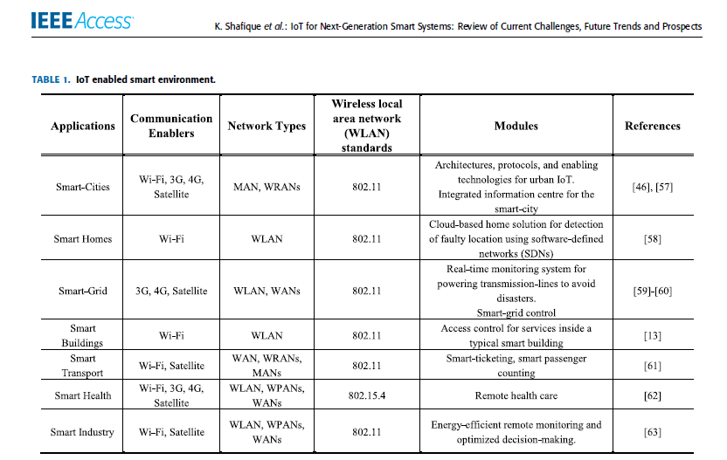
Research (Survey) Paper – Review & Analysis
(IoT for Next Generation)
Muhammad Imran PhD CS BioIIoT-2K2K

Slide 7
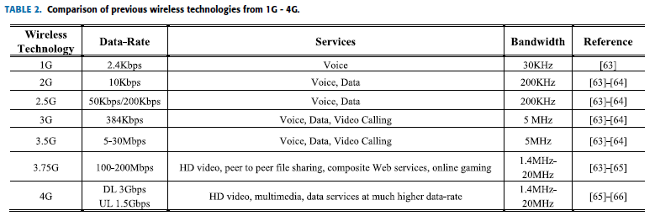
Research (Survey) Paper – Review & Analysis
(IoT for Next Generation)
Muhammad Imran PhD CS BioIIoT-2K2K

Slide 8
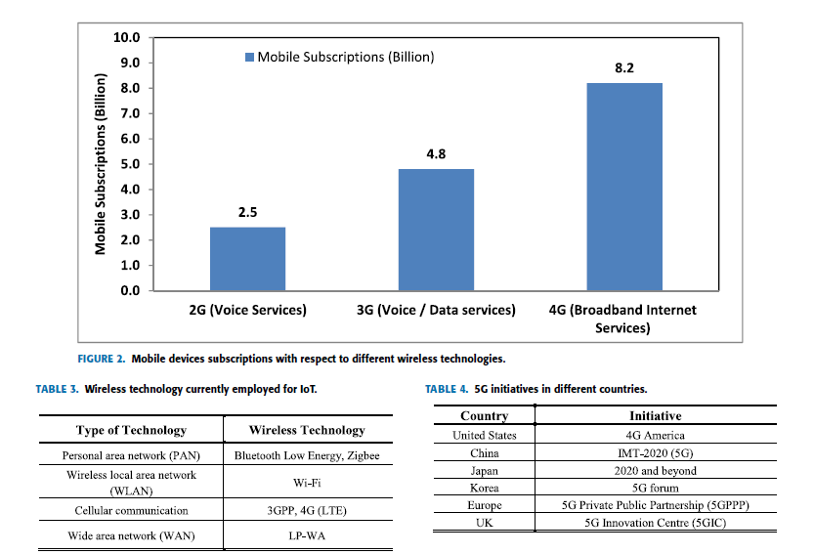
Research (Survey) Paper – Review & Analysis
(IoT for Next Generation)
Muhammad Imran PhD CS BioIIoT-2K2K

Slide 9
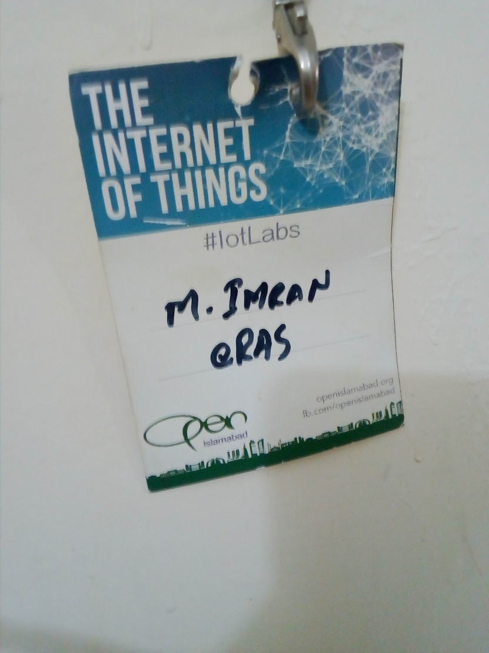

Research (Survey) Paper – Review & Analysis
(IoT for Next Generation)
© 2020 enterprise BioMetrics
mImran@enterpriseRAS.com
300-9829-300
Muhammad Imran PhD CS BioIIoT-2K2K

Slide 10
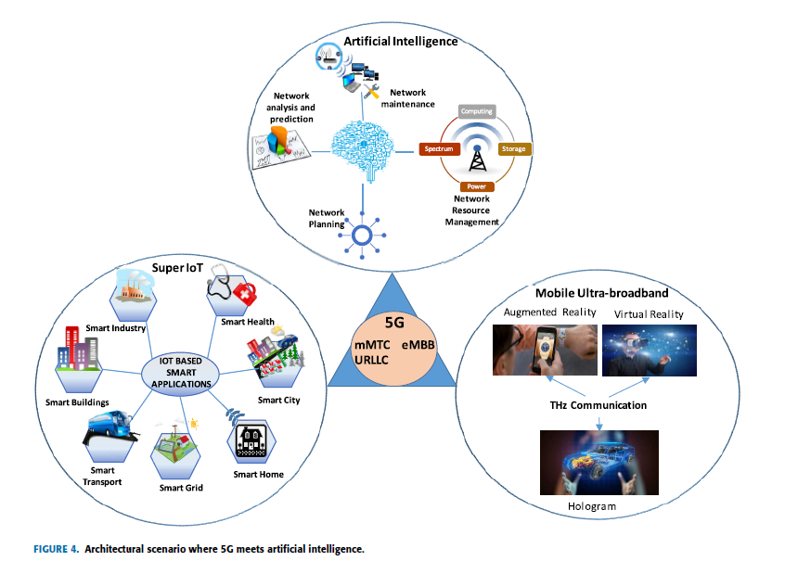
Research (Survey) Paper – Review & Analysis
(IoT for Next Generation)
Muhammad Imran PhD CS BioIIoT-2K2K

Slide 11
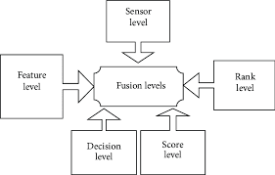


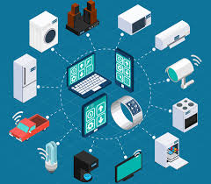
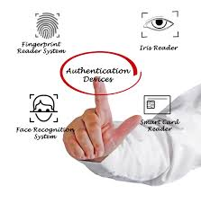

Q & A
Bio-Metrics is the Future of Industrial IoT Security (BioIIoT)
Q & A
Thank You
Muhammad Imran PhD CS BioIIoT-2K2K

